Slide 1
The Risk of Pneumonia in COVID-19 Patients based on Comorbidities
Presentation Draft | Segment 2 Deliverable

Slide 2
Table of Contents
The Risk of Pneumonia in COVID-19 Patients based on Comorbidities

Slide 3
Project Overview
Team Objective
COVID 19 Patients and Pneumonia Risk based on Symptom and Entry Dates
Given the current state of the nation, we hope to answer the question whether or not patients that enter hospitals can get pneumonia based on various factors including, but not limited to: when they entered the hospital, when they started feeling their symptoms, age, and sex.
We plan to use a supervised machine learning model to determine the likelihood of patients catching pneumonia.
Notes:
NR TO ADD SPEAKER NOTES

Slide 4
Methodology
TRACKING PROJECT PROCESS
With the use of our GitHub repository, my team has successfully been able to track progress and necessary inputs with the guidance of Instructors and Teaching Assistants.
DATA GATHERING & CLEANING
Exploring the data online related to COVID-19
Cleaning the data based on needed values
Computing the duration of patients from when they were feeling symptoms and when they entered into the hospital using SQL Queries
PORTRAYING ANALYSIS
The final analysis will be portrayed through an interactive dashboard using Tableau
Notes:
NR TO ADD SPEAKER NOTES

Slide 5
Data Overview
COVID-19 PATIENT DATASET
The dataset retrieved from Kaggle is a combination of anonymous patient data from the Mexican government site.
Our dataset it stored in a pgAdmin server to easily access the large dataset
DESCRIPTION OF DATA EXPLORATION
We replaced all unknown objects with NaN.
Next, we made our primary key for each patient the index.
We dropped the columns id, date_died, and pregnancy.
We also dropped all rows with NaN objects.
Notes:
NR TO ADD SPEAKER NOTES

Slide 6
Data Overview
DESCRIPTION OF DATA EXPLORATION CONTINUED
Created column entry_date_minus_date_symptoms and converted it to days with the data type ‘integer’ for use in our modeling.
We moved the pneumonia column to the end.
Value counts:
Patients with pneumonia = 35,505
Patients without pneumonia = 15,869
~ 9:4 ratio
Notes:
SN
Created column entry_date_minus_date_symptoms, which represents the number of days the patient had symptoms before being admitted into the hospital, and converted it to days with the data type ‘integer’ for use in our modeling.
We moved the pneumonia column to the end so that it would be easier to use when assigning ranges to x and y variables.
We checked the value counts and ensured those with and without pneumonia were balanced.

Slide 7
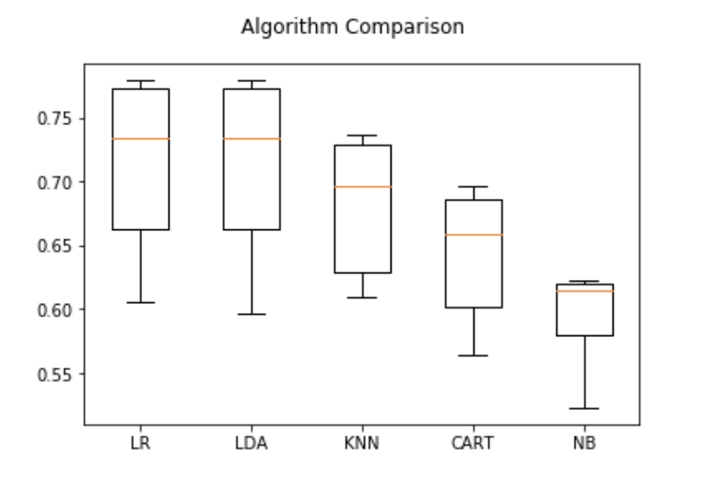
Data Analysis: Supervised Modeling
x = all columns excluding pneumonia
y = pneumonia
Cross validation accuracy score (standard deviation):
Logistic Regression: 0.7146 (0.06)
Linear Discriminant Analysis: 0.7138 (0.06)
K Nearest Neighbor Classifier: 0.6809 (0.05)
Decision Tree Classifier: 0.642150 (0.05)
Gaussian Naive Bayes: 0.5973 (0.03)
Figure 1. This figure compares the accuracy scores of the supervised models through a box and whisker plot, with logistic regression having the greatest accuracy score.
Notes:
SN The independent variables for these models were all columns excluding the index and pneumonia. The dependent variable was pneumonia. Below are the cross validation accuracy scores with their respective standard deviations for each model. As you can see, logistic regression had the greatest accuracy score, making it the ideal model for this dataset.

Slide 8
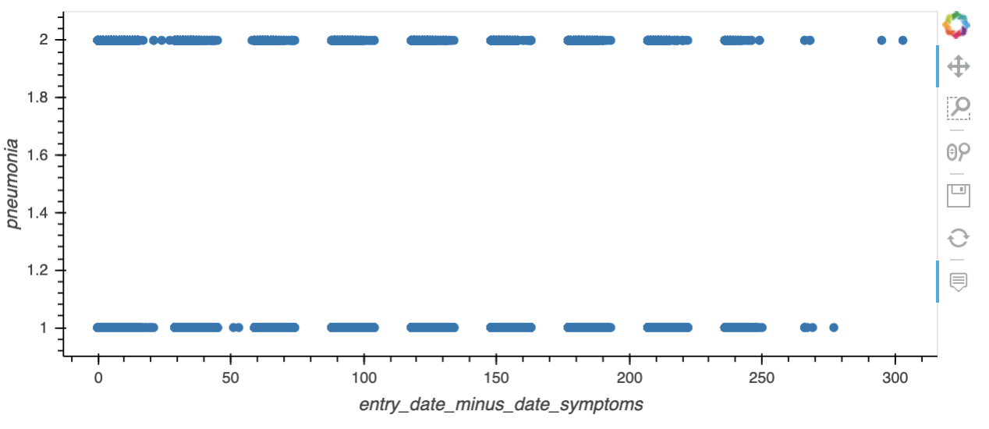
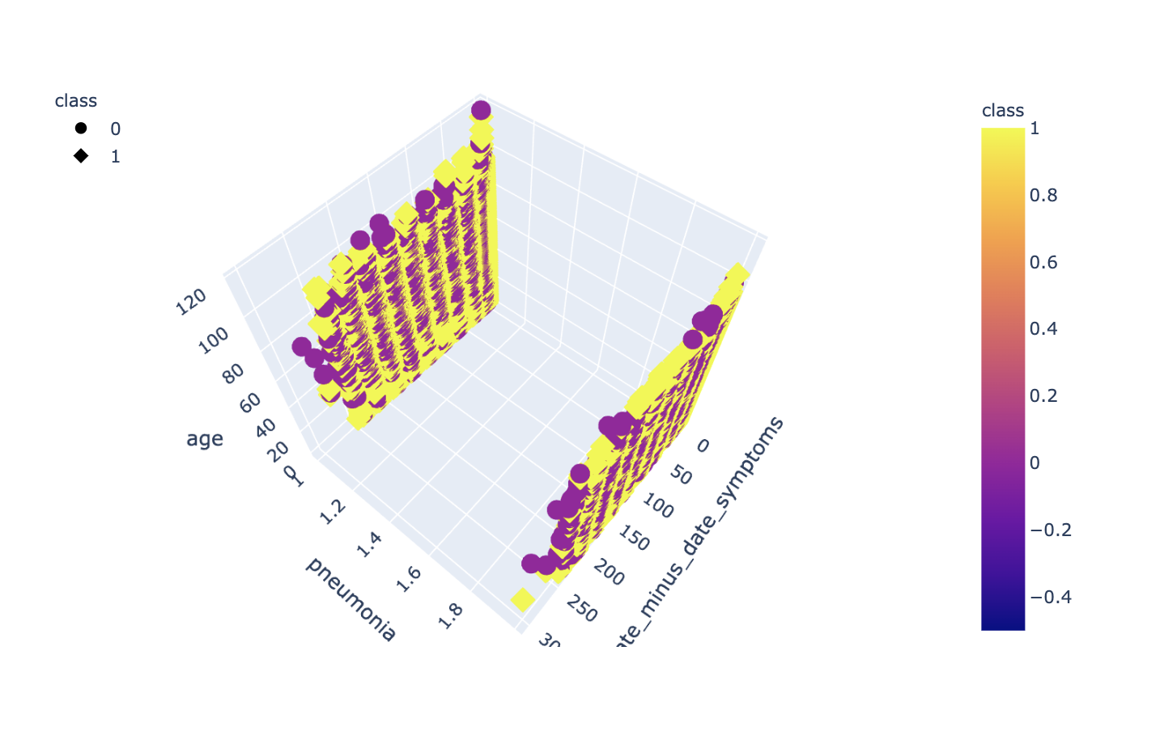
Data Analysis: Unsupervised Modeling
Figure 2. This figure compares the variable entry_date_minus_date_symptoms, which represents the number of days the coronavirus patient had symptoms before being admitted into the hospital, with the incidence of pneumonia through an unsupervised machine learning model.
Figure 3. This figure depicts entry_date_minus_date_symptoms vs. pneumonia vs. age in a 3-Dimensional graph, revealing no clear conclusion as the data is evenly distributed across variables.
Notes:
SN When plotting different variables against each other, we noticed that because most variables are binary and since they had even distributions among variables, the plots did not have clear clusters from which to analyze. Entry_date_minus_date_symptoms was evenly distributed among pneumonia outcome. Even after fitting for the most accurate number of clusters using an elbow plot, applying it to a K-Means model still did not show clear results, as seen from the 3D plot of entry_date_minus_date_symptoms vs pneumonia vs age.

Slide 9
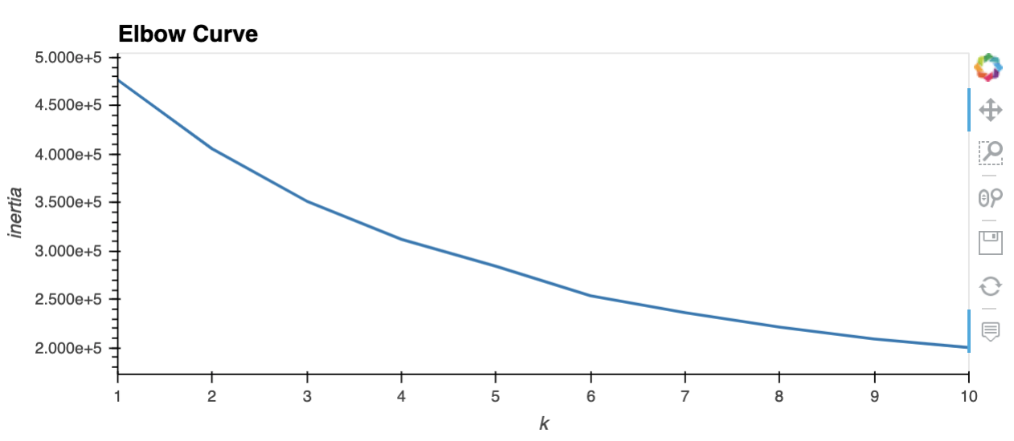
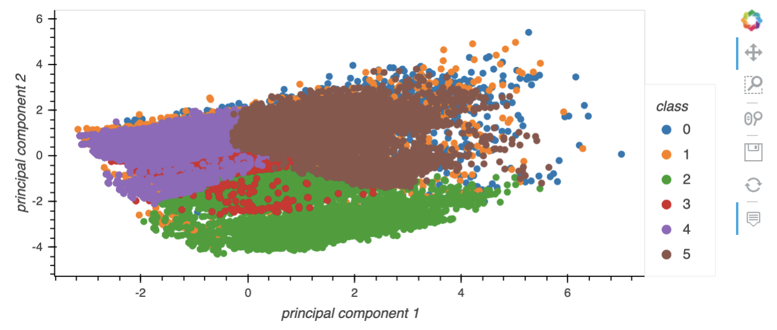
Data Analysis: PCA
Figure 4. This figure portrays the step in PCA analysis where we found the appropriate value of K, 6, for use in the K-means model based on the value of inertia.
Figure 5. This figure shows an example of an ambiguous plot comparing principal components 1 and 2 together based on nine classes.
Notes:
SN
First, we standardized objects in the data frame using StandardScalar.
Then, we initialized the PCA model using the transformed data.
We added more principal components until the sum of the explained variance ratio equaled above 50%.
We calculated the inertia for a range of K values and found the appropriate number using the elbow curve.
We initialized the K-means model, fit the model, predicted the number of clusters, and plotted principal components against each other.
We then used sklearn's train_test_split function on the data with all columns except pneumonia for x and pneumonia for y.
We transformed the training and testing groups with PCA and analyzed them with logistic regression.
The accuracy score turned out to be 0.6946, which is less than that of the supervised machine learning logistic regression model.

Slide 10
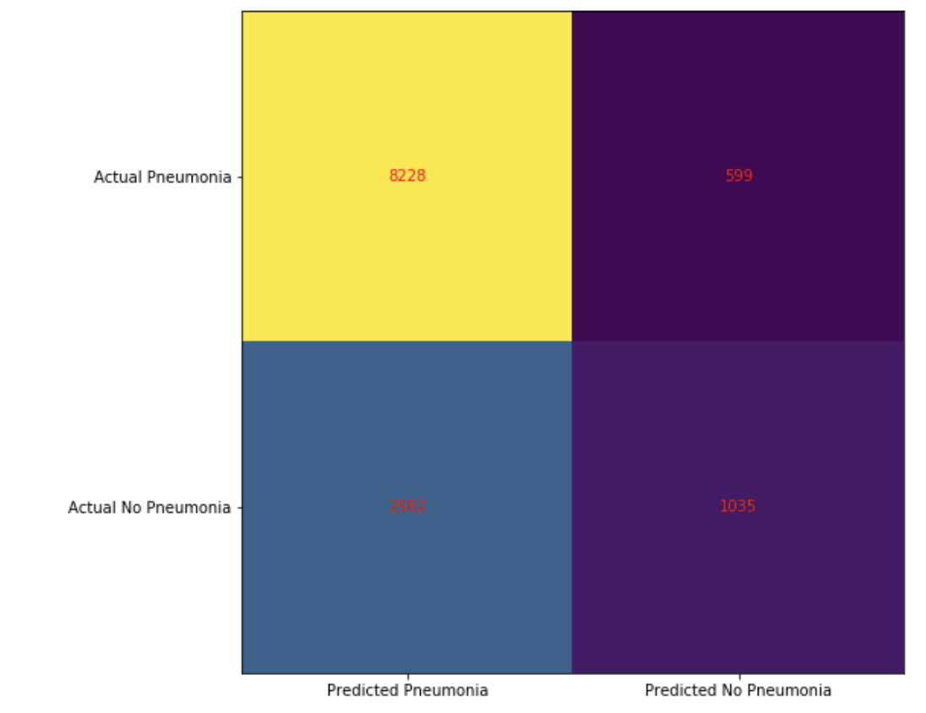
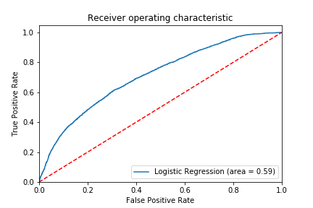
Analysis Results
Figure 6. Insert Caption
Figure 7. Insert Caption
Notes:
SN Logistic Regression through Supervised Machine Learning had the model with the highest accuracy.

Slide 11
Recommendations
Find data from other countries that had additional attributes to compare or if they had the same related to pneumonia, what other factors may have caused it
Find data with a reliable source to draw accurate conclusions since there is a lot of disinformation with COVID-19 data available
Repeat analysis with supervised, unsupervised, and PCA transformed machine learning models in the future when data is more readily available since COVID-19 is new
Notes:
[NR] Speaker Notes:
Some of our recommendations include finding other reliable data sources from other countries that that the same or additional attributes to compare and contrast
Having a reliable source of data would also mean that we could draw more accurate conclusions. THe problem with our data is that COVID-19 data is new and it can be misinformed at this early state. Doing this study at a later date in time (if and when COVID ends), may be able to tell us a different and more accurate story.

Slide 12
Interactive Dashboard
The interactive dashboard will be through the use of Tableau
[ dropdown of variable 1]
[ dropdown of variable 2]
Specified Date Range
Graph of comparison for variable 1 & 2
Some data about that date range
Notes:
NR TO ADD SPEAKER NOTES and dashboard recording

